Slide 1


FIFTHSTRATEGY
ISTHISAVALIDTEAMNAME?

Slide 2

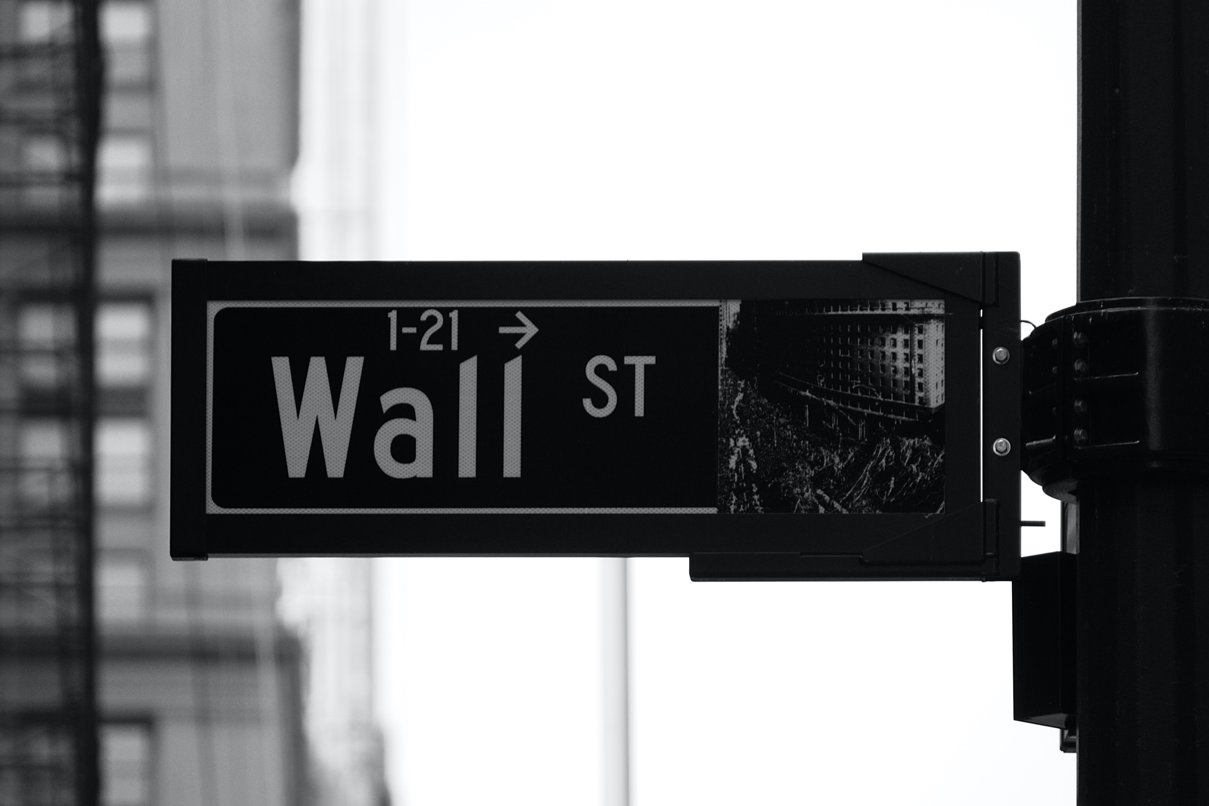
PROBLEMS WITH
CURRENT SYSTEM
BROKERS
We want to remove situations like where a investor incurs loss because of the broker's mistake, malpractices done by brokers, where we have to pay brokerage for every transaction even if it leads to loss because we believe that one should not suffer because of wrong doings of others.

Slide 3

OUR SOLUTION
What we are envisioning is a web/mobile app that automates the process of investing in stocks. Basically we are planning to make a Auto Trader tool with the help of Machine learning and Artificial Intelligence that will automatically invest users money in stock market and deliver best returns/profits to users.

Slide 4
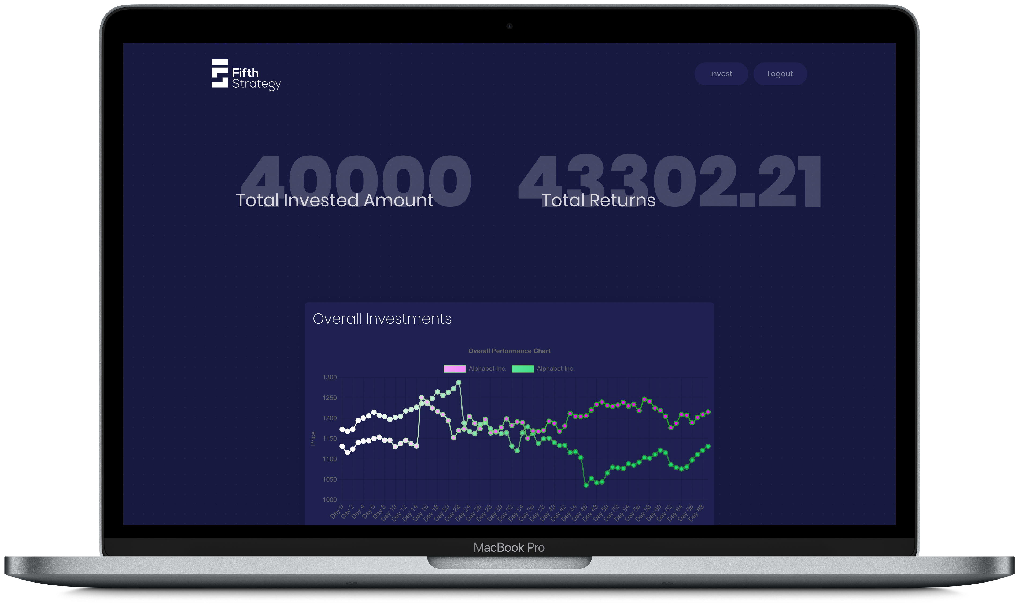

DEMONSTRATION
LAPTOP PREVIEW
WEB APPLICATION FOLLOWS MINIMALISTIC AND FLAT DESIGN UI.`

Slide 5
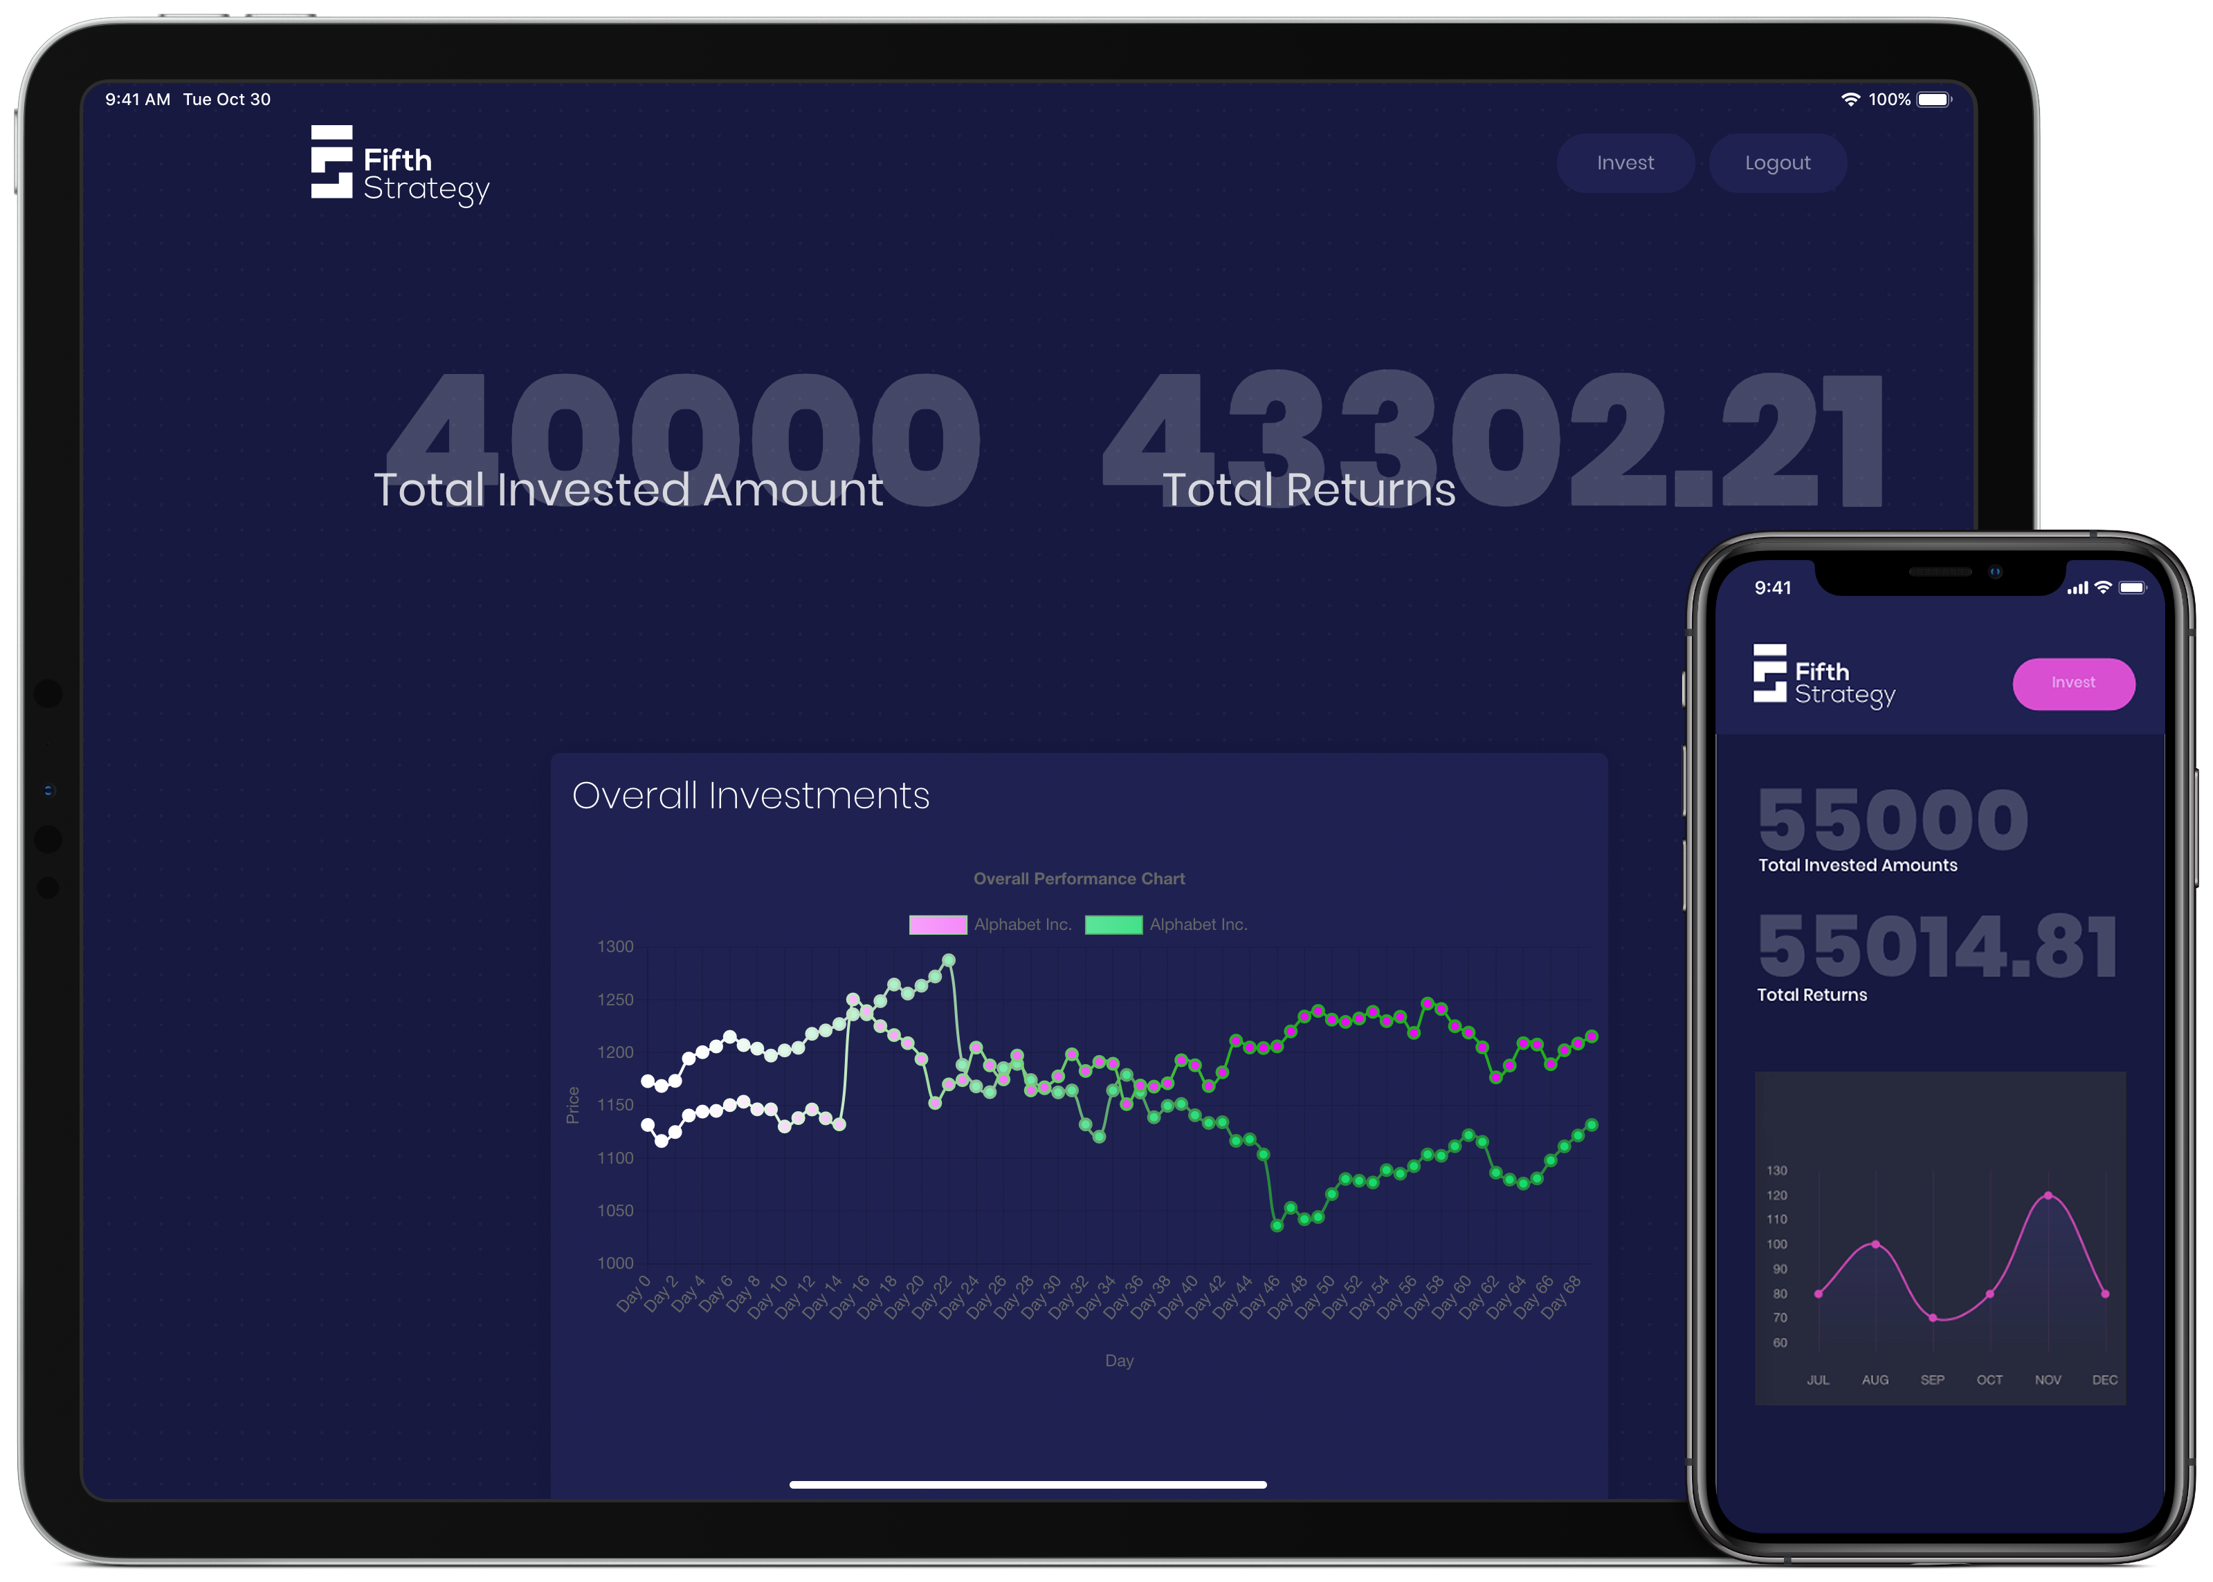
DEMONSTRATION
MOBILE & TABLET PREVIEW
FULLY RESPONSIVE WEB APPLICATION

Slide 6
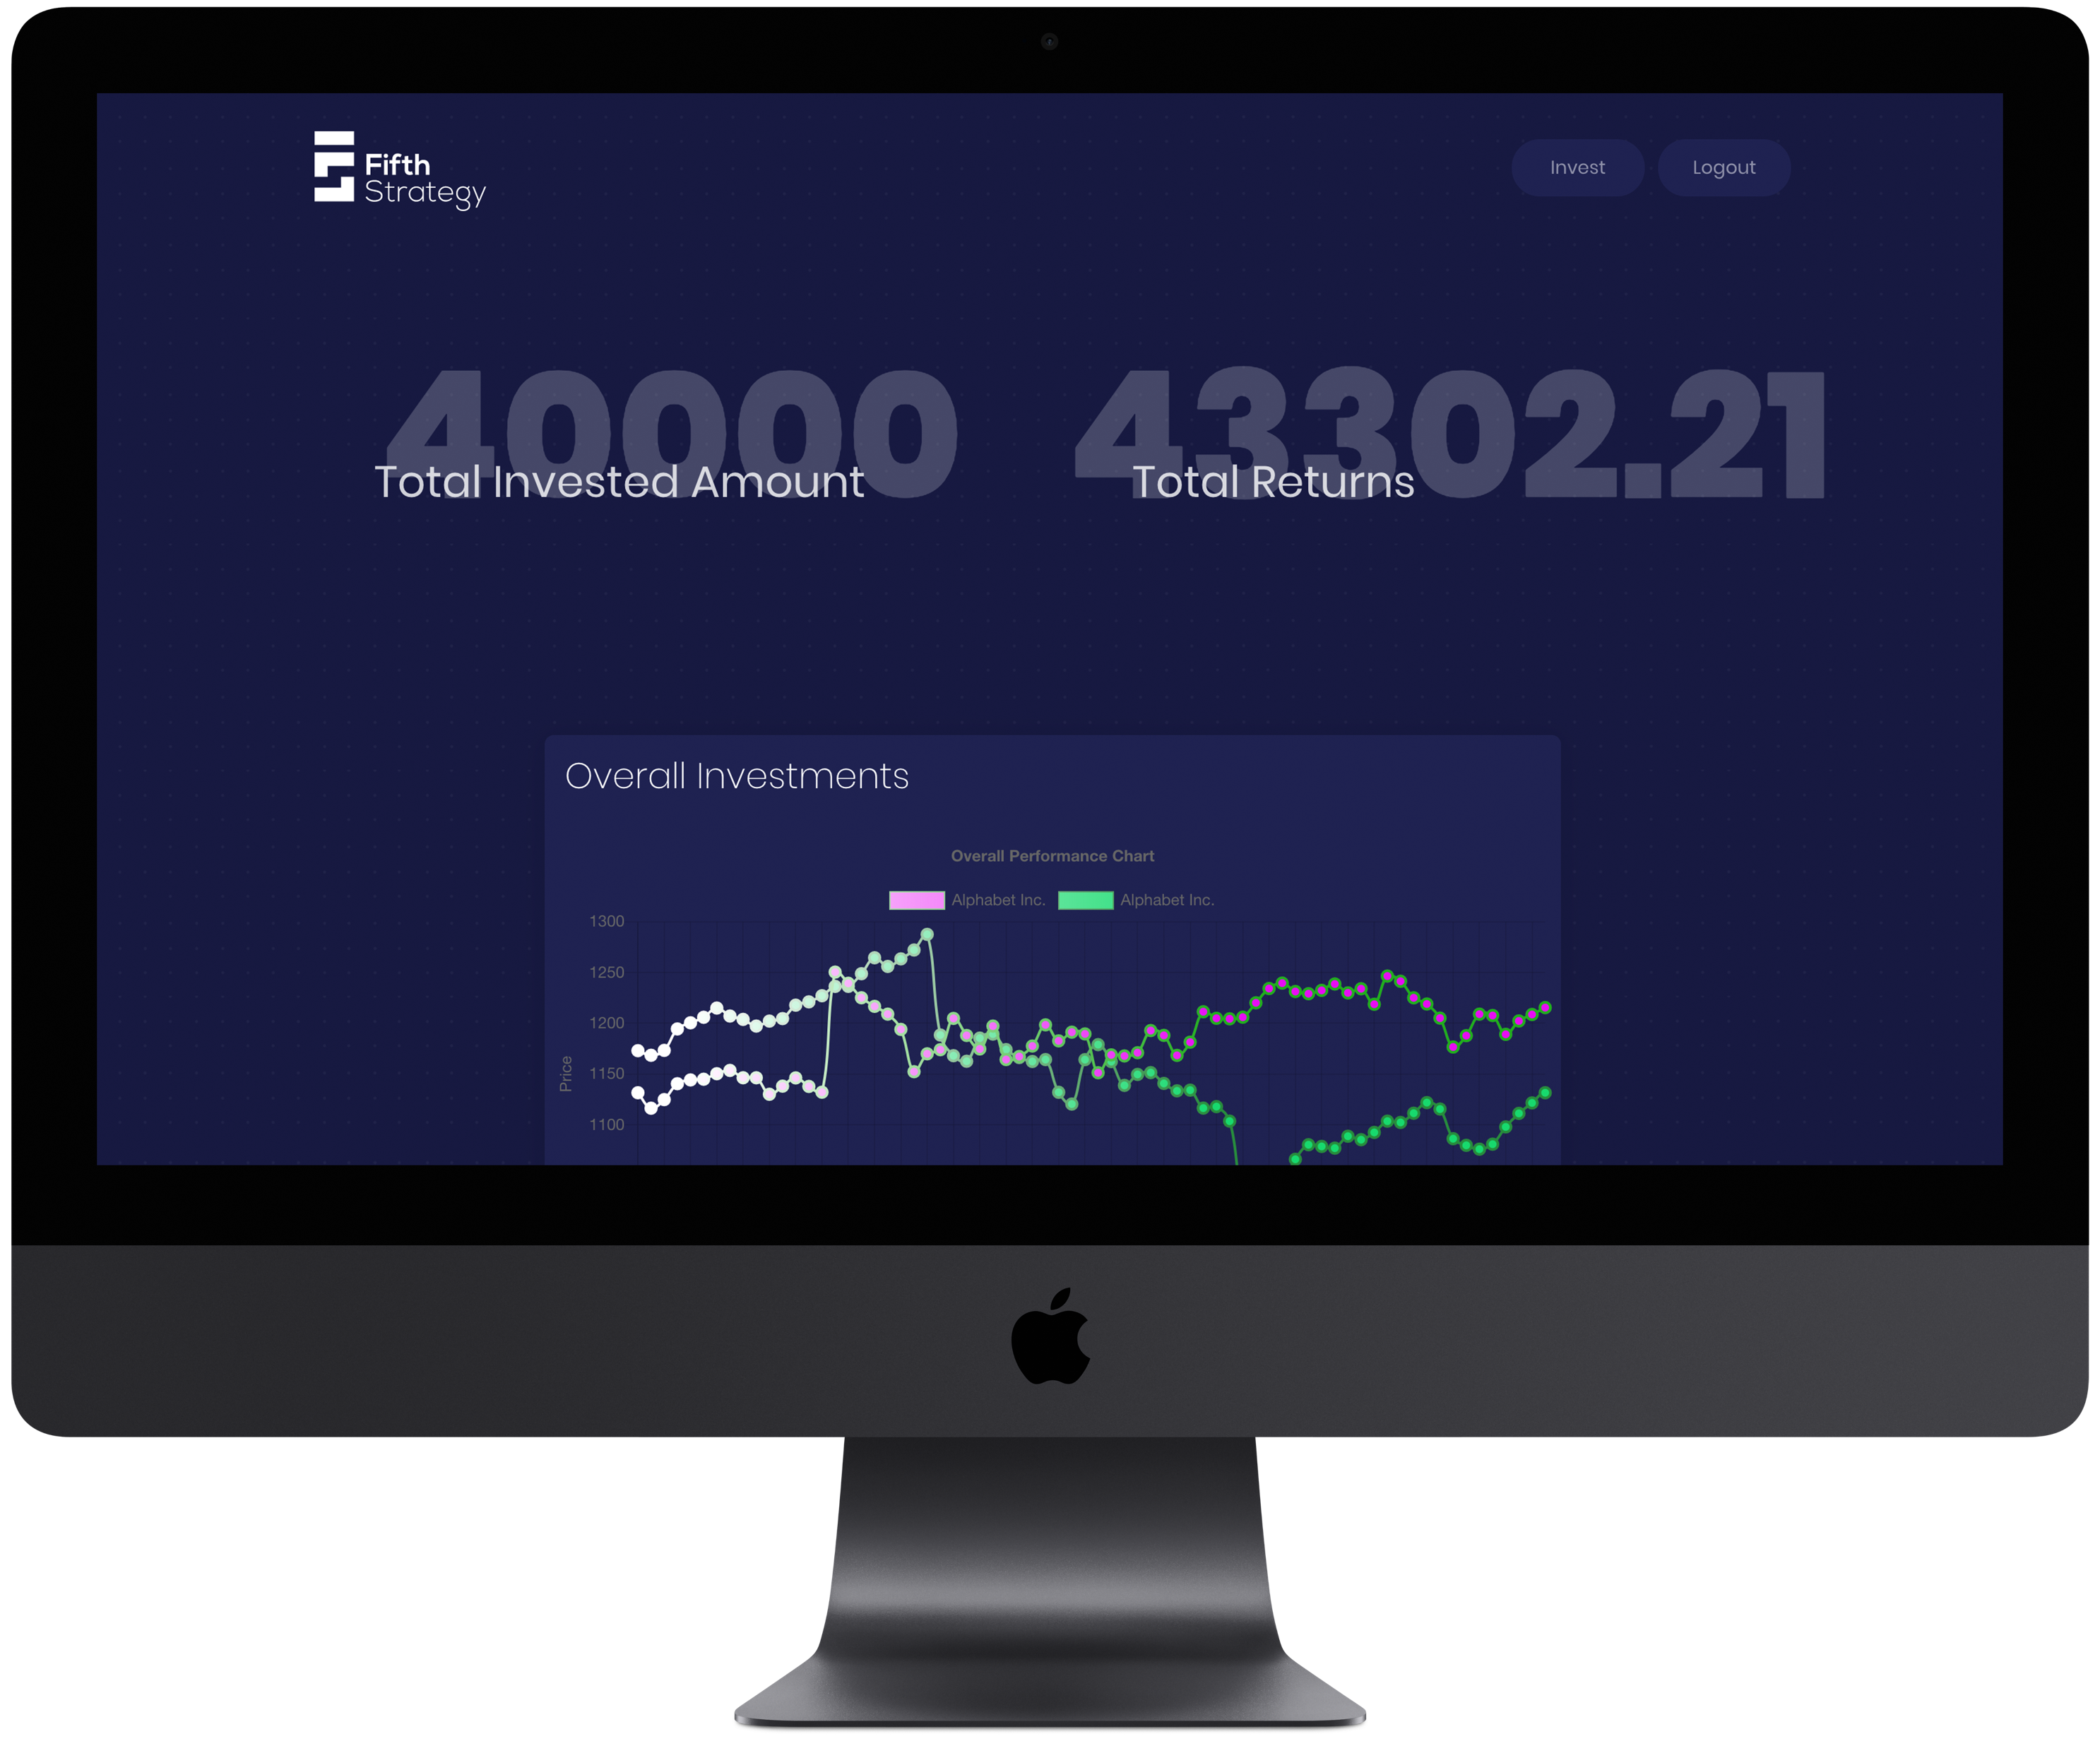
USP
UNIQUENESS OF
FIFTHSTRATEGY
FifthStrategy targets the common people who have little to no knowledge of stock market and trading.
We provides a easy to use platform for these people to enter stock market and earn money.

Slide 7

FUTURE SCOPE
TECHNICAL
Buy more or less shares depending upon the risk factors provided the user.
Buy shares of various companies for better risk management.
Integrate sentiment analysis to better analyse and predict the upcoming trend.

Slide 8

FUTURE SCOPE
BUSINESS
5% of profit, charged on every withdrawal.
Provide SaaS by suggesting stocks to purchase and sell rather than direct selling or purchasing.

Slide 9
ANY QUESTIONS?

Slide 10

THANK YOU
BY ISTHISAVALIDTEAMNAME?

